Slide 1

CMR COLLEGE OF ENGINEERING & TECHNOLOGY
Kandlakoya, Medchal, Hyderabad - 501401
Department of Computer Science and Engineering
DETECTING MALICIOUS SITES
Batch No.:49
Name of the student:
20H51A0564 G.Naveen
20H51A0566 I.Sree Anvita
20H51A0591 Farheen
Under esteemed guidance of
Ms.B.Gayathri
Assistant Professor
Batch: 2020-2024 Major Project Phase 1

Slide 2
Outline
Abstract
Introduction
Research Objective
Problem Definition
Scope of the Project
Literature Review
Implementation of Existing system
Conclusion
References
Notes:
2

Slide 3
Abstract
Notes:
3

Slide 4
ABSTRACT
There are number of users who purchase products online and make payment through various websites.There are multiple websites who ask user to provide sensitive data such as username, password or credit card details etc. often for malicious reasons. This type of websites is known as phishing website. n order to detect and predict phishing website, we proposed an intelligent, flexible and effective system that is based on using classification Data mining algorithm. We implemented classification algorithm and techniques to extract the phishing data sets criteria to classify their legitimacy.
Once user makes transaction through online when he makes payment through the website our system will use data mining algorithm to detect whether the website is phishing website or not. This application can be used by many E-commerce enterprises in order to make the whole transaction process secure. Data mining algorithm used in this system provides better performance as compared to other traditional classifications algorithms. With the help of this system user can also purchase products online without any hesitation.

Slide 5
INTRODUCTION
Notes:
5

Slide 6
Introduction
There are number of users who purchase products online and make payment through various websites.
There are multiple websites who ask user to provide sensitive data such as username, password or credit card details etc. often for malicious reasons.
This type of websites is known as phishing website. Phishing is an internet scam in which an attacker sends out fake messages that look to come from a trusted source.
A URL or file will be included in the mail, which when clicked will steal personal information or infect a computer with a virus.
Traditionally, phishing attempts were carried out through wide-scale spam campaigns that targeted broad groups of people indiscriminately.
It has become one of the most powerful and harmful of all the cyber-attacks. Because of lack of adequate identification techniques and protective methods, phishing methods are becoming common day by day.
Notes:
6

Slide 7
Research Objective
Notes:
7

Slide 8
Research objective
The objective of this project based on the research is to train machine learning models and deep neural nets on the dataset created to predict phishing websites.
Both phishing and benign URLs of websites are gathered to form a dataset and from them required URL and website content-based features are extracted.
The performance level of each model is measures and compared.

Slide 9
Problem Definition
Notes:
9

Slide 10
Problem Definition
Develop a machine learning model that can classify websites as legitimate or phishing based on website features using machine learning techniques

Slide 11
Scope of the Project
Notes:
11

Slide 12
Scope of the Project
The administrator has the full fledged rights over this system.
Users can easily detect malicious sites
It also has the capability to adapt to newly occurred malicious sites

Slide 13
Literature Review
Notes:
13

Slide 14
Comparison table for the existing system
S.No | Authors and Journal Name& Year of publication | Problem Statement | Name of the Proposed solution/Method | Solution | Remarks
1 | Hassan Y. A. Abutai In 2017 | Many classifications techniques have been used and devised to combat phishing threats, but none of them is able to efficiently identify web phishing attacks due to the continuous change and the short life cycle of phishing websites. | The proposed system is highly adaptive and dynamic as it can easily adapt to detect new phishing attacks with a relatively small data set in contrast to other classifiers that need to be heavily trained in advance | We test our system using different scenarios on a balanced 572 phishing and legitimate URLs. Experiments show that the CBR-PDS system accuracy exceeds 95.62%, yet it significantly enhances the classification accuracy with a small set of features and limited data sets | Doesn’t effectively find the attacks
2 | M. Moghimi. In 2016. | new rule-based method to detect phishing attacks in internet banking | New rule-based phishing detection method | It is based on two novel feature sets. proposed two feature sets to improve the performance of detecting phishing attacks and preventing data loss in internet banking webpages. | proposed feature sets are entirely depending on the webpage content. Attacker may spend more time to redesign the phishing webpage
3 | Marchal, S., Francois, J In 2014 . | Despite the growth of prevention techniques, phishing remains an important threat since the principal countermeasures in use are still based on reactive URL blacklisting | Phish storm | PhishStorm can interface with any email server or HTTP proxy..hence they define the new concept of intra-URL relatedness and evaluate it using features extracted from words that compose a URL based on query data from Google and Yahoo search engines | This application gives efficient output upto 96.4% with only 1.44% false positives

Slide 15
Comparison table for the existing system
S.No | Authors and Journal Name& Year of publication | Problem Statement | Name of the Proposed solution/Method by authors | Solution | Remarks
4 | Prajak Pachput &Sanket Shinde | Many of the detections prefer Deep learning and neural networks because previous methods don’t give efficient output | deep learning for phishing detection | DDNN, CNN, and RNN/LSTM are the algorithms used and implemented on tensor flow keras platforms | deep learning-based models require a long training time when compared to the traditional machine learning algorithms
5 | Nguyen, H.K | The URL Verification project centers on the critical task of ensuring the legitimacy and security of web addresses that users interact with. | Verify the URL | implementation of URL verification involves several key steps, including planning and requirements analysis, selection of appropriate verification systems, integration with existing infrastructure | A major challenge is the potential for legitimate websites to be incorrectly flagged as malicious, leading to user frustration
6 | Mohit Singhal, Nihal Kumarswamy In 2021 | Email filtering is a critical cybersecurity project designed to safeguard users and organizations from the ever-present threat of malicious emails, including phishing attempts, malware distribution, and spam | Email Filtering | Selection of Filtering Solutions, Configuration and Tuning, User Training,Monitoring incident response, compliance with regulation | Advanced phishing or malware attacks can sometimes bypass email filters.

Slide 16
Implementation of Existing System
Selection of Filtering Solutions: Choose and deploy email filtering software or services, which may include on-premises solutions or cloud-based services.
Configuration and Tuning: Fine-tune filtering rules to balance security and usability, reducing the chances of false positives while maintaining protection.
User Training: Conduct user education and awareness programs to ensure users understand the role of email filtering and how to handle filtered messages.
Monitoring and Incident Response: Implement monitoring and response mechanisms to address and investigate suspicious emails and potential threats.
Compliance with Regulations: Ensure that email filtering practices align with relevant data privacy and security regulations.

Slide 17
Steps to Implement
Use csv file to get URLs
Send a request to each URL and receive a response by requests library of python
Use the content of response and parse it by BeautifulSoup module
Extract features and create a vector which contains numerical values for each feature
Repeat feature extraction process for all content\websites and create a structured dataframe
Add label at the end to the dataframes | 1 for phishing 0 for legitimate
Save the dataframe as csv and structured_data files are ready!
Check "structured_data_legitimate.csv" and "structured_data_phishing.csv" files.
After obtaining structured data, you can use combine them and use them as train and test data
You can split data as train and test like in the machine_learning.py first part, or you can implement K-fold cross-validation like in the second part of the same file. I implemented K-fold as K=5.
Then I implemented five different ML models:
Support Vector Machine
Gaussian Naive Bayes
Decision Tree
Random Forest
AdaBoost
You can obtain the confusion matrix, and performance measures: accuracy, precision, recall
Finally, I visualized the performance measures for all models. Naive Bayes is the best for my case.

Slide 18
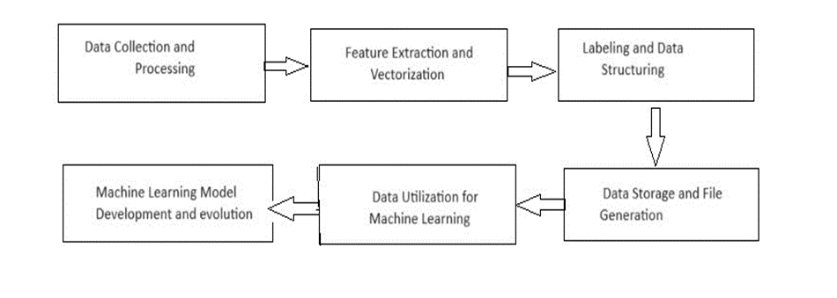
UML DIAGRAM

Slide 19
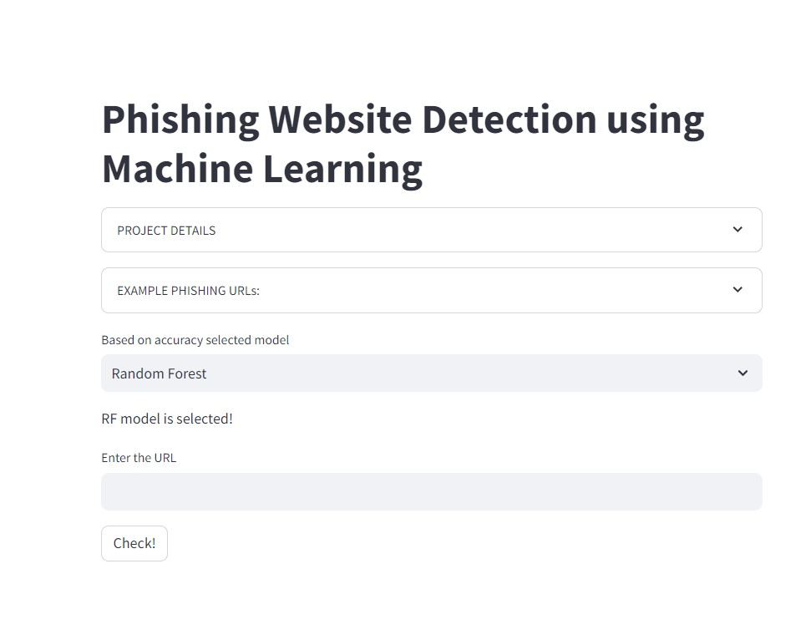
Result
The project takes the input in URL format and tells if the site is malicious or not
The algorithms used in this are random forest,adaboost, dnn ect
Pycharm, Numpy, pandas , Matplot, Sklearn are used

Slide 20
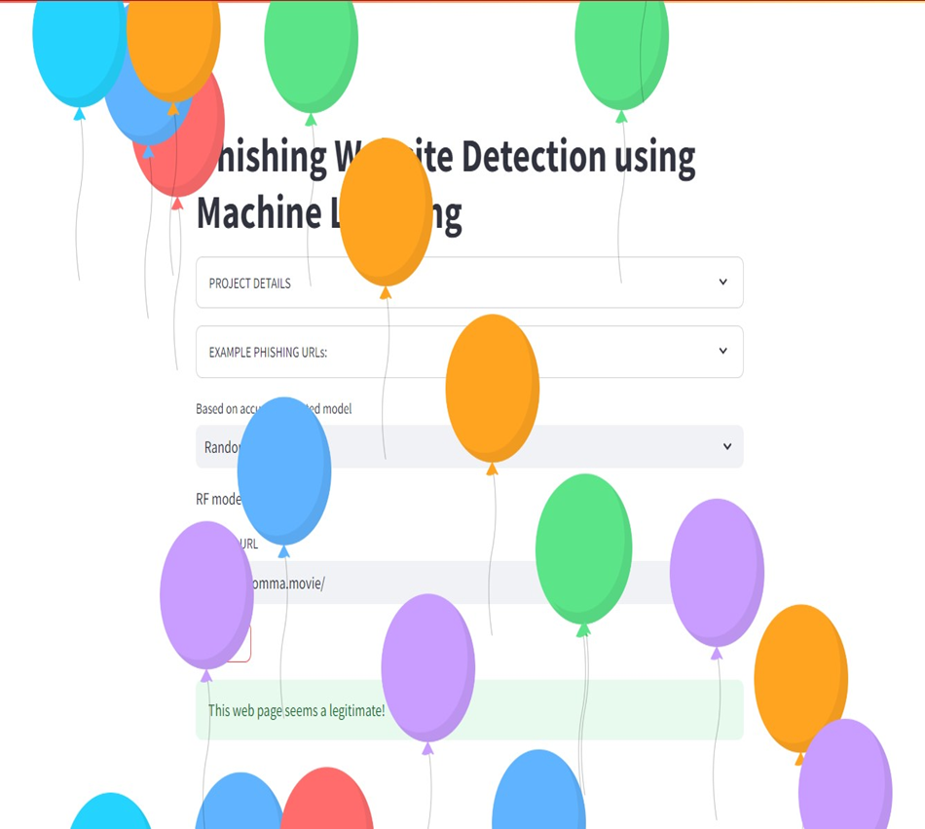
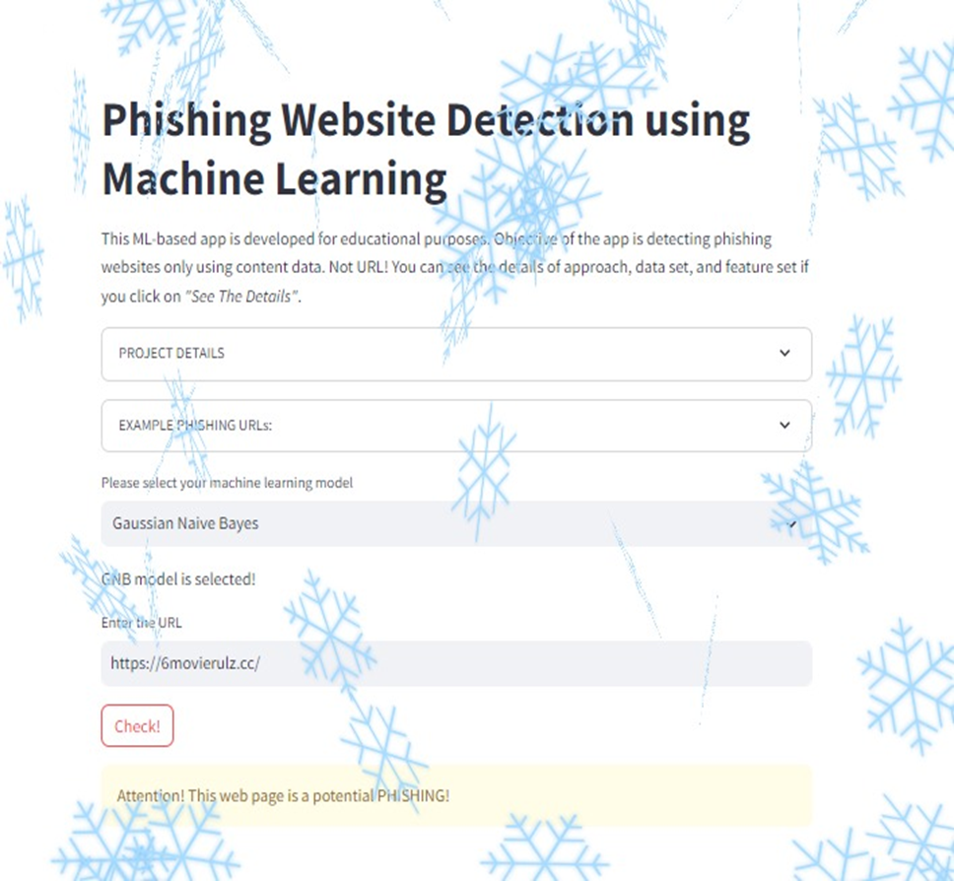
Outputs of the website:

Slide 21
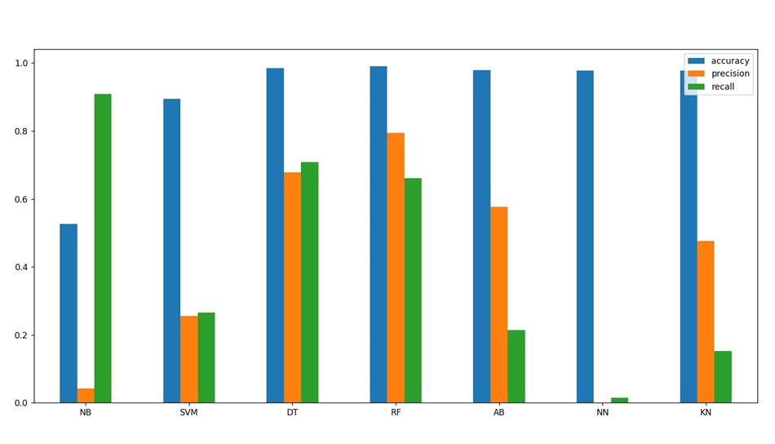
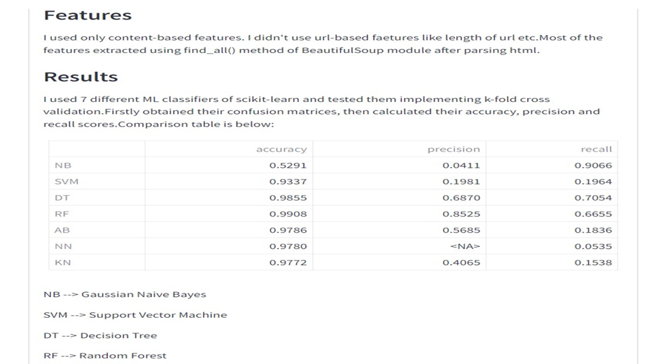

Slide 22
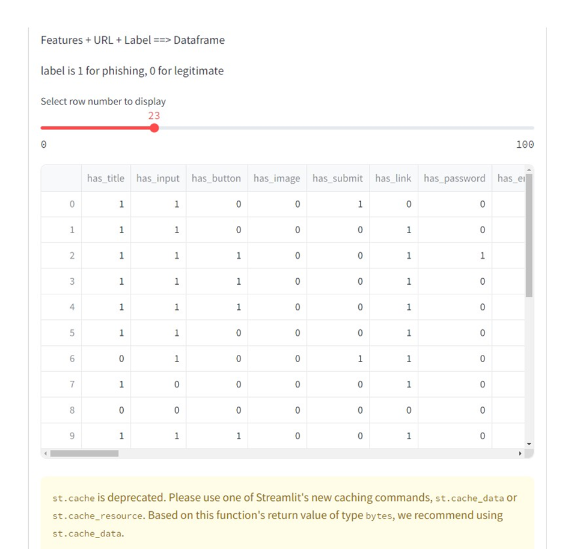
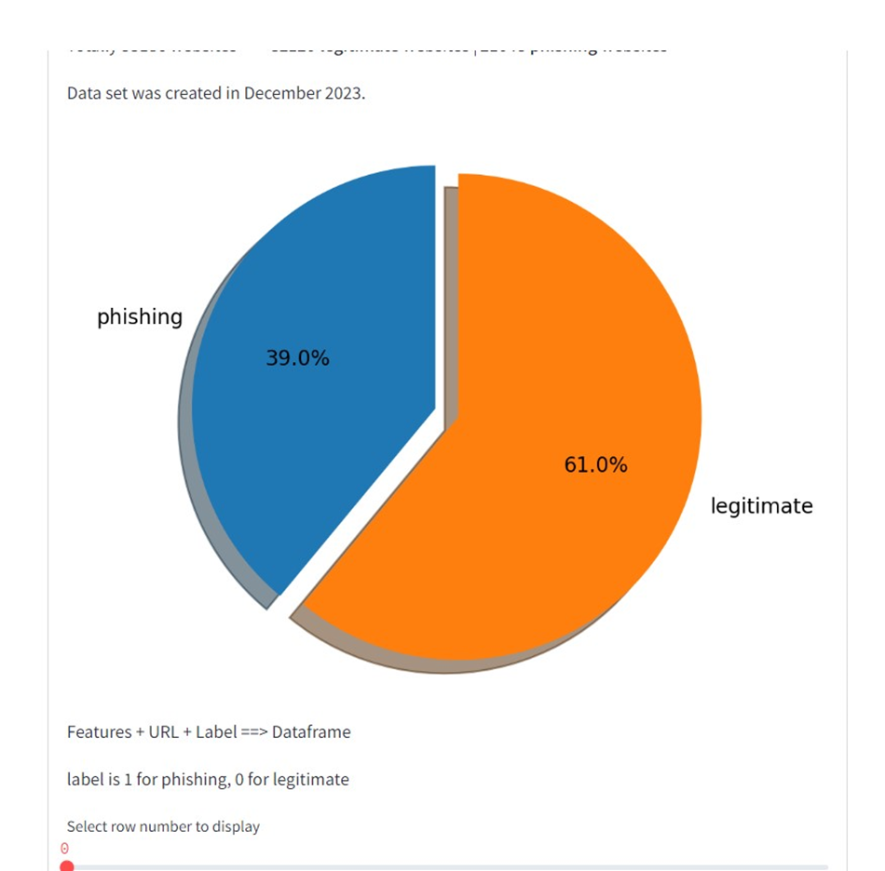

Slide 23
Conclusion
In this project, we have explored how well to classify phishing URLs from the given set of URLs containing benign and phishing URLs.
We have adopted a simple approach to extract the features from the URLs using simple regular expressions.
we have not used the content based features as the main problem with the content-based strategy for detecting phishing URLs is the non-availability of phishing web-sites and the life span of the phishing website is small, and it is difficult to train an ML classifier based on its content-based features.
We conclude that successful techniques in detecting phishing website URLs were summarized As phishing websites increases day by day, some features may be included or replaced with new ones to detect them.

Slide 24
References
https://link.springer.com/10.1007/s10207-023-00686-y
https://ieeexplore.ieee.org/document/9396014
https://ieeexplore.ieee.org/document/8101455
https://www.annalsofrscb.ro/index.php/journal/article/view/4752.
https://www.researchgate.net/publication/351676213

Slide 25
Thank You!

